Slide 1
Hướng dẫn cài đặt chạy Python trên server

Slide 2
Agenda

Slide 3
1. Install required applications
Để phục vụ cho việc upload source và test trên server, Install những application sau:
Kerio Control VPN
FileZilla
PuTTY (SSH)

Slide 4
2. Install required Python modules
Install những modules sau (library cho Python) trên server:
pickle
subprocess
selenium
time
datetime
requests
json
webdriver_manager

Slide 5
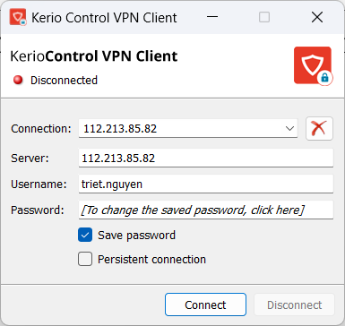
3. Upload source files to server
Step 1: Login to Kerio Control VPN

Slide 6
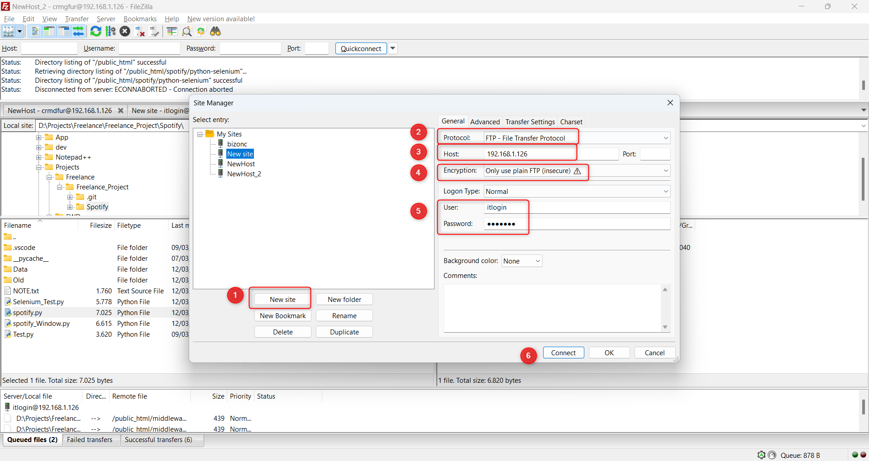
3. Upload source files to server
Step 2: Login to FileZilla
Site Manager, create a new site
Protocol FTP
Host
Only use plain FTP
Insert user/Password
Connect to server

Slide 7
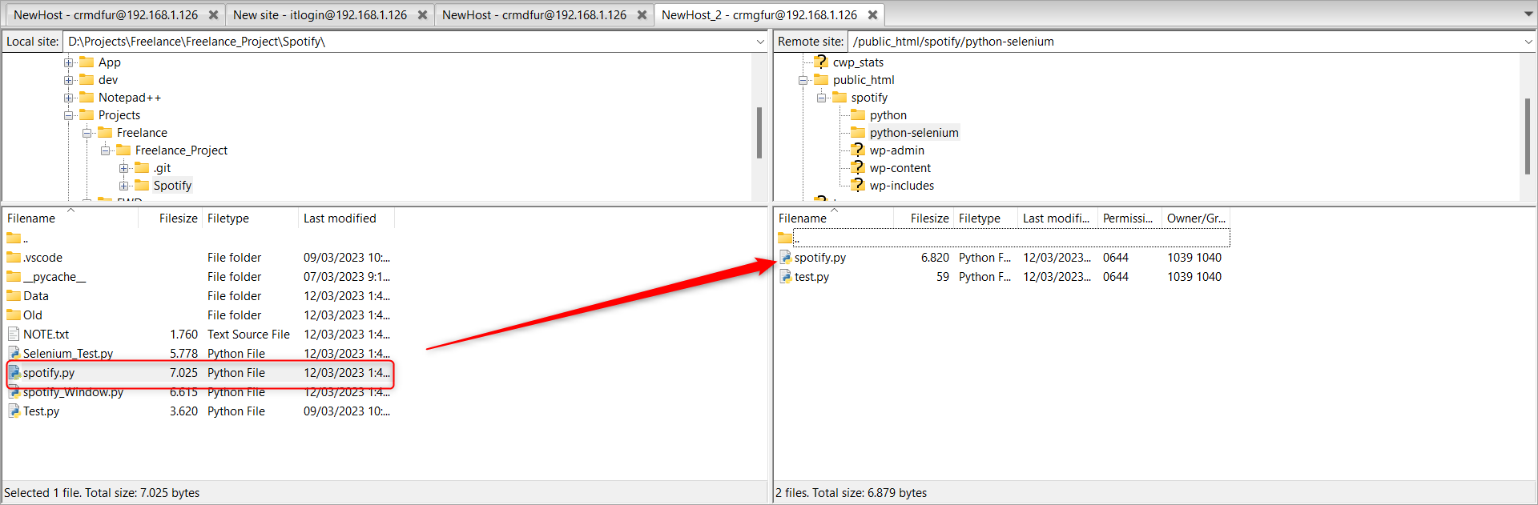
3. Upload source files to server
Step 3: Drag source files from local to server folder

Slide 8
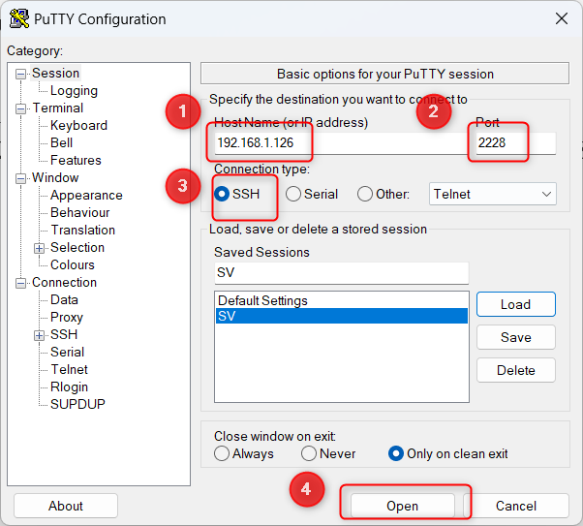
4. PuTTY
Step 1: To access Linux server via SSH tunnel, to test sources.
We use PuTTY.
Host
Port
Connection Type
Connect to server

